Slide 1
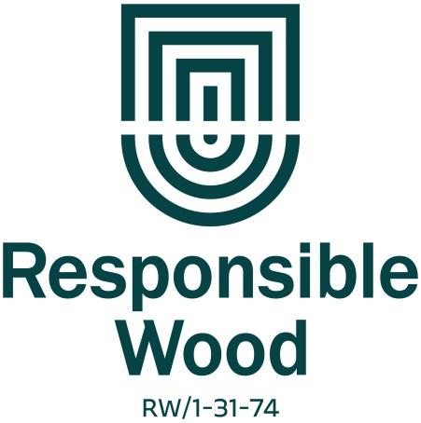
PEFC 21-31-74
Certification No.: 250
Chain of Custody AS 4707-2014
Highland Pine Products
Highland Pine Products have been awarded AFS Chain of Custody certification based on the Rolling Average Percentage system.
Rolling Average Percentage: 93.7%
AFS Certified for all products sold in
Nov 2019
ACN 093 059 404
A Joint Venture Company between
Boral Timber and AKD Softwoods
Locked Bag 8, Oberon, NSW, 2787, Australia

